Slide 1

MEDIA & THE PUBLIC
Week 12 Selective exposure
Ryan Wang
ryanyang@psu.edu

Slide 2
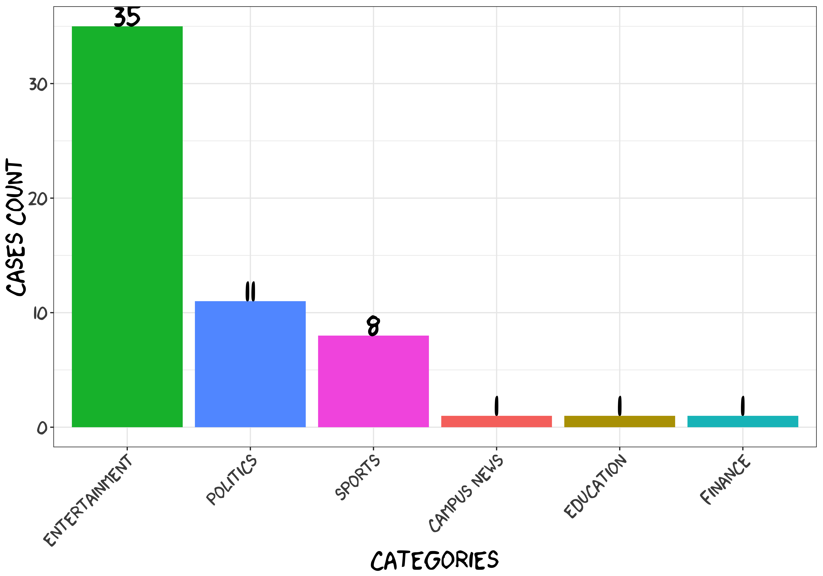
How does our media diet look like?

Slide 3
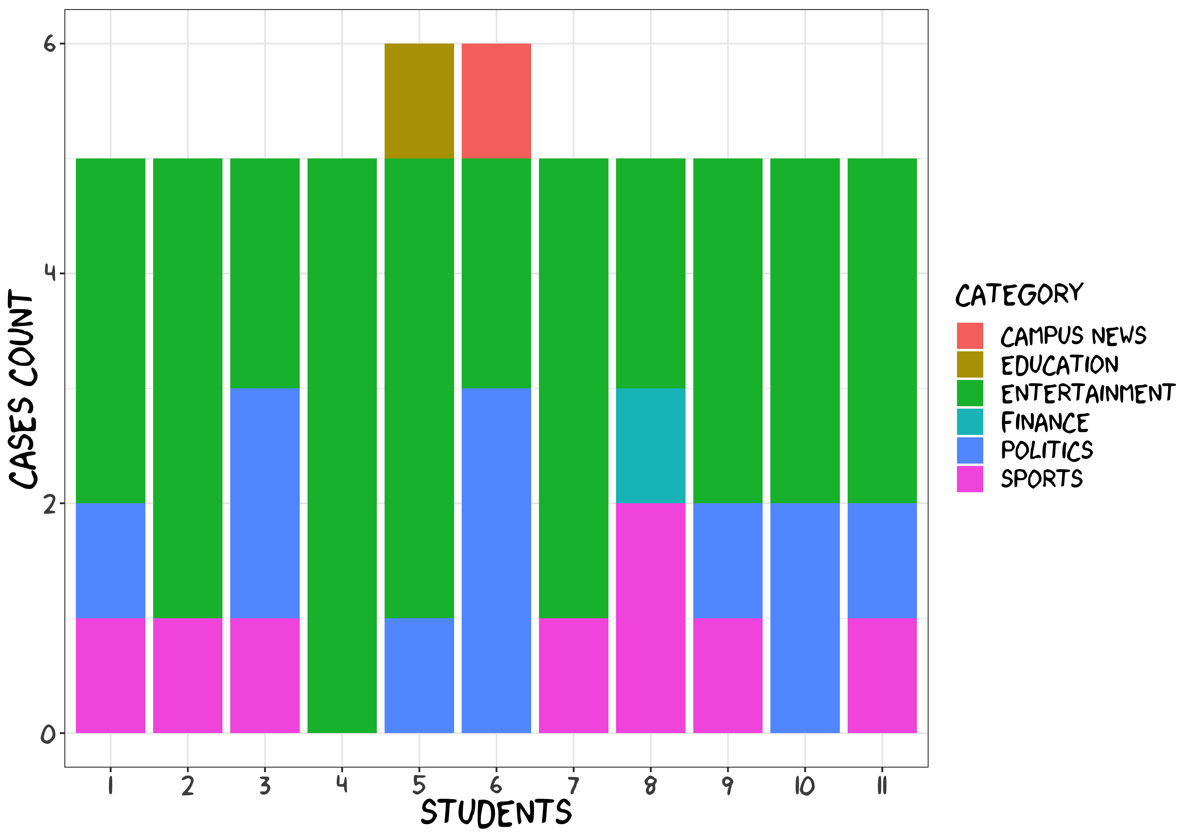
How does our media diet look like?

Slide 4
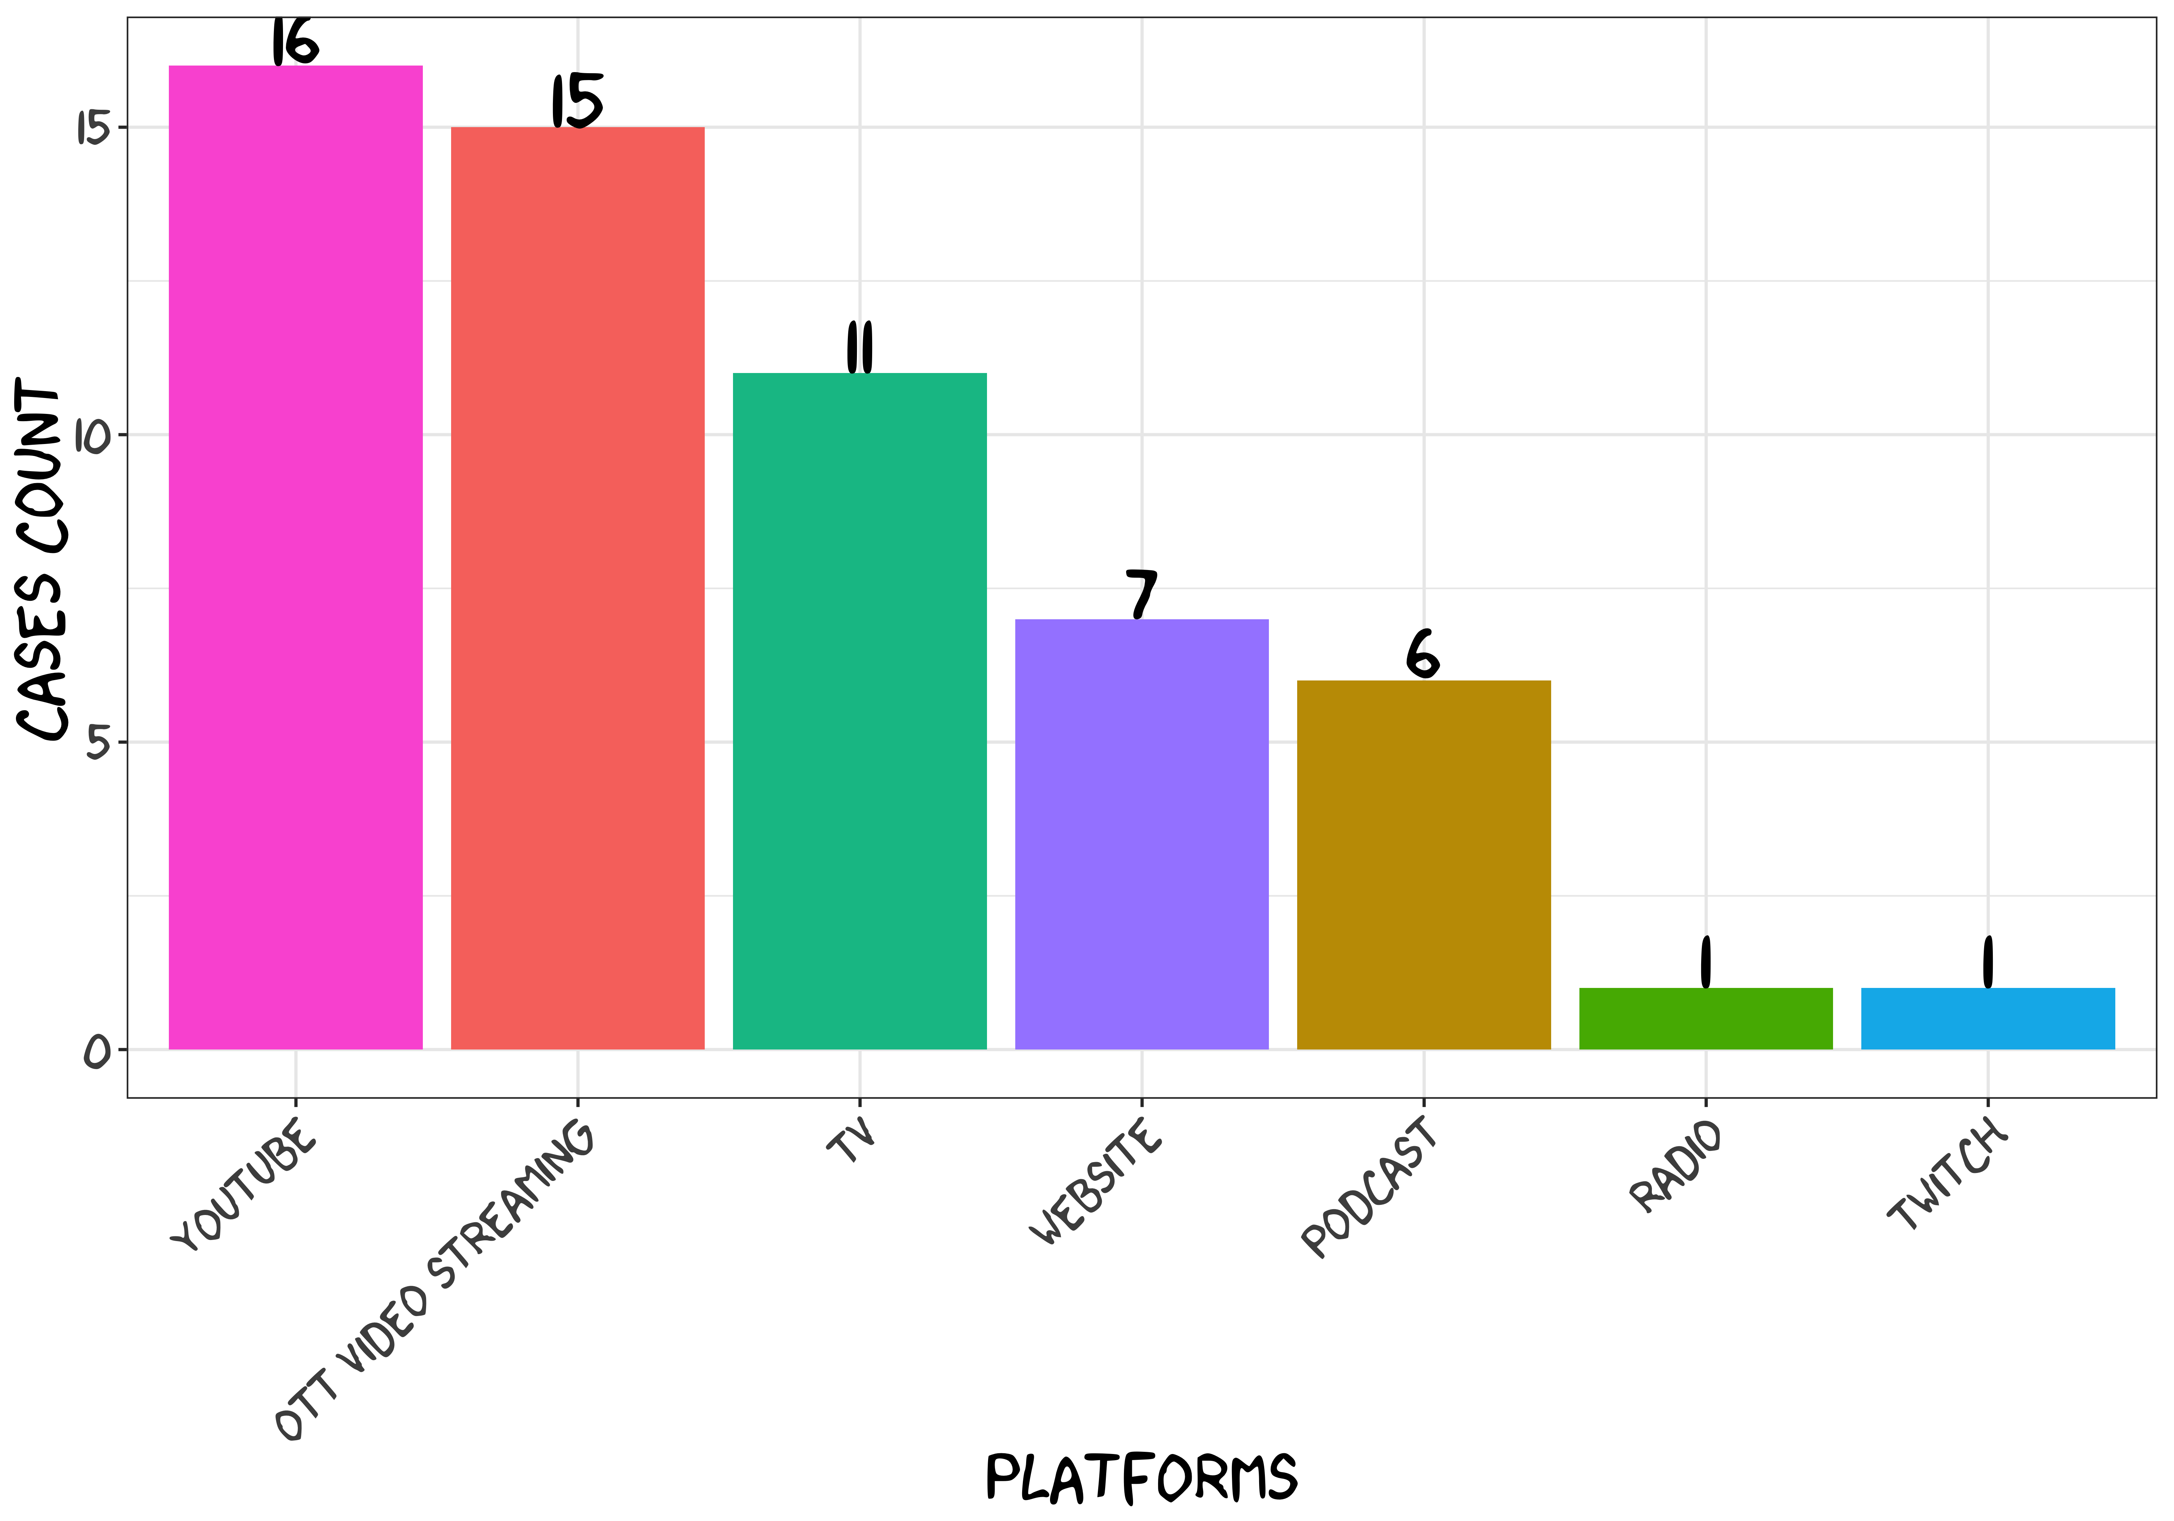
How does our media diet look like?

Slide 5
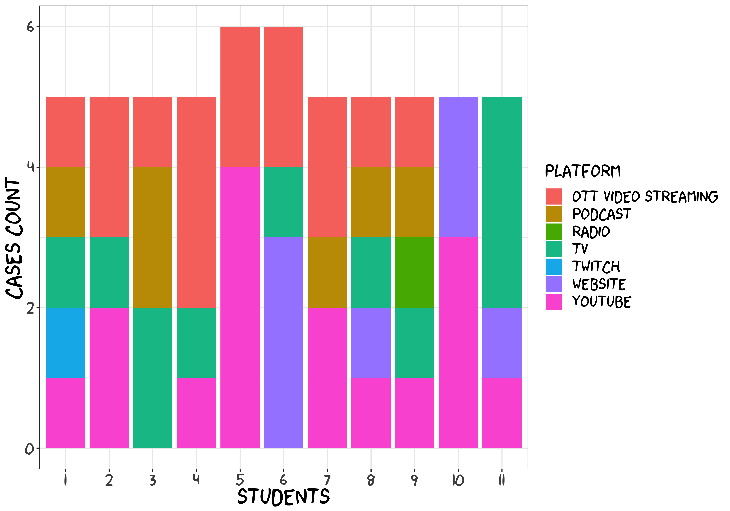
How does our media diet look like?

Slide 6
Definition
Selective exposure (Klapper, 1960)
The (purposefully) motivated selection of messages that are congruent with and confirm people’s pre-existing attitudes and beliefs.
1940 presidential campaign (Lazarsfeld, Berelson & Gaudet, 1948)
Selection perception
Selection retention
Confirmation bias (Wason, 1960)
Individuals may actively seek out and assign more weight to information that supports their current attitude (vs. “filtering”)
History:
Early research: a common explanation for why scholars have not uncovered more evidence of power media effects
Mid-1960s: mixed evidence (methodological flaws?)
1970s-1980s: a call for return
2000 -: renewed research attention (media environment?)
Notes:
We do not have the time, energy, desire, or ability to look at everything. Why do we gravitate toward some messages, some individuals, and some media and not to others? Investigations of selective exposure aim to provide some insight
selective perception, when people are confronted with unsympathetic material, either they do not perceive it or they make it fit for their existing opinion;
selective retention, when people simply forget attitude-incongruent information
confirmation bias, and impacts the way in which people search for, interpret, and recall information
lthough selective exposure is a phenomenon that extends beyond political com­ munication research, stronger selective exposure effects have been found for political topics

Slide 7
(Possible) Explanatory mechanism
Cognitive dissonance theory (Festinger, 1957)
When cognitions conflict, an individual can expe­rience the highly undesirable state of cognitive dissonance
Selective exposure is one of several tools at an individual’s disposal to reduce the dissonant state or the feelings of anxiety
Motivated reasoning (Kunda, 1990)
People can be moved to select messages by accuracy goals and by directional goals, which are more likely to seek like-minded(supportive) infor­mation
Less cognitive effort (Ziemke, 1980)
Influence of moods and emotions (Kim, 2010; Valentino et al., 2009)
Negative moods enhance selective exposure
Anger and fear may prompt different patterns of selective exposure
Emotions affect information search
Anxiety sparks more balanced search
Information quality (Matzger et al., 2015)
High-quality in­ formation will be preferred over that which is of low quality
People believe that like-minded information is more credible and of higher quality
Notes:
Anxiety sparks more balanced search when individuals expect that they will be asked to defend their views as opposed to when individuals do not have this expectation.

Slide 8
Types of selective exposure
News or entertainment
Whether people will opt for news or for en­tertainment when given the choice
“Relative entertainment preference” (Prior, 2007)
Messages about different issues
Which issues motivate people to gather more information
The issue-public membership (Iyengar et al., 2008)
Medium
More emphasis on the chosen medium
More choices on Internet
The degree to which citizens choose like-minded information
Interpersonal context
People tend to discuss politics with those with whom they already agree (Mutz, 2006)
New media environment
Partisans are more likely to select like-mind­ ed media outlets (Stroud, 2008, 2011)
Political issues: abortion, affirmative action, and gun ownership (Knobloch-Westerwick and Meng, 2009)
Notes:
When cable television diffused, the additional televi­ sion channel options gave unengaged citizens more opportunities to avoid watching presi­ dential speeches and debates (Baum and Kernell, 1999). The increased choice provided by cable enabled citizens to switch to entertainment if they so desired during these politi­ cal moments. Prior’s (2007) extensive research confirms that as media choice has in­ creased owing to cable television and the Internet, citizens have been empowered to avoid the news. Prior’s measure of “relative entertainment preference” shows that those preferring entertainment can and do opt out of news exposure when they have access to more media options.
which issues motivate people to gather more information. Some citizens are members of issue publics, or groups finding certain issues to be particularly important (Converse, 1964). These citizens select information relevant to their issue-public membership more frequently than information about other issues. Health-care workers, for example, are more likely than others to read health-care information (Iyengar et al., 2008). Those finding an issue personally important tend to se­lect more information on the issue versus those who do not find the issue as important (Kim, 2009).
In particular, some hypothesize that because the Internet allows more choice, people prefer to go online for information when they dis­ agree with or do not trust the reportage in more mainstream outlets

Slide 9
Other categorizations
Belief-motivating exposure
Mediated and interpersonal selective exposure
People encountered more diverse political views through their media use than in their interpersonal interactions (Mutz & Martin, 2001)
Nature of choices (different levels of commitment)
One-time choice vs. Habitual choice
A habit of relying on a particular source demonstrates a greater commitment
Reading an article or browsing a website requires little dedi­cation
Notes:
The authors antici­pated that as media choices increased, however, people might encounter less diversity in the media.

Slide 10
Moderators of selective exposure
Individual characteristics
Certainty of position (+)
Attitude strength (+)
Political knowledge (+)
Mortality salience (+)
Defensive confidence (-)
Need for cognition (-)
Environmental characteristics
Information utility (override confirmation bias)
Options of one’s choice
Constraints on how people select information
When in­formation is presented sequentially (+)
How much information people can select
Network homogeneity (+)
Social media endorsement (+)
Notes:
several recent studies have found that certainty enhances it. Strongly held attitudes also moti­vate greater selective exposure than weaker ones
The politically knowledgeable are more likely to select politically like-minded media source
Mortality salience, making people think about their deaths, enhances selective exposure in some cases: awareness of the inevitability of one's death.
Defensive confidence: people's perceptions that they can defend their attitudes against contradictory information coming from the environmen
The Need for Cognition is a psychological construct that concerns an individual's tendency and enjoyment in seeking, evaluating, and integrating multiple relevant sources of information toward making sense of their surroundings
informa­tion perceived as useful may be selected more frequently whether it is congenial (p. 536) or not (Frey, 1986). Indeed, research does show that informational utility does prompt more exposure to online news (Knobloch, Carpentier, and Zillmann, 2003) and can over­ ride a bias for confirmatory information.
When given more options from which to choose, peo­ ple have greater opportunity to cater to their preferences. For example, those with a pref­ erence for entertainment are more likely to select entertainment as opposed to news when they have more options. People also are more likely to select like- minded information when given more choices
When in­formation is presented sequentially, as opposed to simultaneously, selective exposure is enhanced

Slide 11
Empirical approaches
Self-reported survey
Measurement bias
de facto selective exposure?
Temporal order
Attitude – Media exposure? Or Media exposure – Attitude
Laboratory studies
Quasi-experiment
Experiment
Forced vs. selective exposure
Unobtrusive measurement
Digital trace tracking
Observation in the waiting room (The magazine experiment)
Nielsen television ratings and Nielsen NetRatings
Notes:
Some exam­ine the correlation between participants’ stated beliefs and their self-reported media ex­ posure (Sweeney and Gruber, 1984). Others directly ask respondents the extent to which they prefer like-minded information
randomly assign participants either to a choice condition whereby they can select their media exposure or to a forced expo­ sure condition whereby they are required to use media without choice
Dr. Stroud recruited participants for a television viewing study. While waiting for it to begin, the subjects were allowed to read magazines, choosing freely among liberal (The nation), the conservative (The National Review) and the neutral options, with covers making those orientations plain. A confederate in the waiting from recorded the time each subject spent reading the various print options. Conservatives spent substantially more time reading the conservative magazines than the liberals did, although it is worth noting that liberals apprear to have spent more time reading conservative magazines than liberal or neutral ones.

Slide 12
Future directions
Is selective exposure an all-or-nothing phenomenon?
Solely use like-minded information and engage in se­lective exposure
Not engaging in selective exposure
In reality: selective exposure may mean exhibiting a preference for like-minded informa­tion
How long spent with a congenial source should be counted as selective exposure?
Selective exposure vs, selective avoidance
Although public may be prone to seek like-minded information, public may not be equally motivated to avoid information with which we disagree
How does the Internet/Social media/Algorithm encourage/discourage selective exposure
Outcomes of selective exposure:
Is it democratically troubling? – Political polarization; Declinism
What is the solution?
Encourage more exposure to diverse points of view – boomerang effect or public inactivity?
Notes:
After all, attending only or primarily to like-minded political content is related to polarization, different conceptions of the world in which we live, and heightened partisan reactions
The exodus from political life of those more interested in entertainment than the news also could be judged as trou­bling
Declinism is the tendency to see the past in an overly positive light and to view the present or future in an overly negative light, leading us to believe that things are worse than they used to be.

Slide 13
Reference
Stroud, N. J. (2017). Selective exposure theories. In Kenski, K. & K. H. Jamieson (Eds.) The Oxford handbook of political communication. https://doi.org/10.1093/oxfordhb/9780199793471.013.009_update_001

